Slide 1
Boye 23 – Lightning talks
A divers and inclusive local community
Anders Kirkedal Nielsen, Aarhus Kommune
Nov. 09, 2023

Slide 2
You are going to hear about
Warm welcome
Why diversity and inclusion?
New feld - the use of the Aarhus Compas
Tools in the organization
Inclusion of the whole board
Lessons from policy process
Question

Slide 3
Why diversity and inclusion?
Source: The Economist, august 2022

Slide 5
The Aarhus Compas

Slide 6
Tools we use (De-biasing processes & Mentoring)

Slide 7
Lessons learned (1)

Slide 8
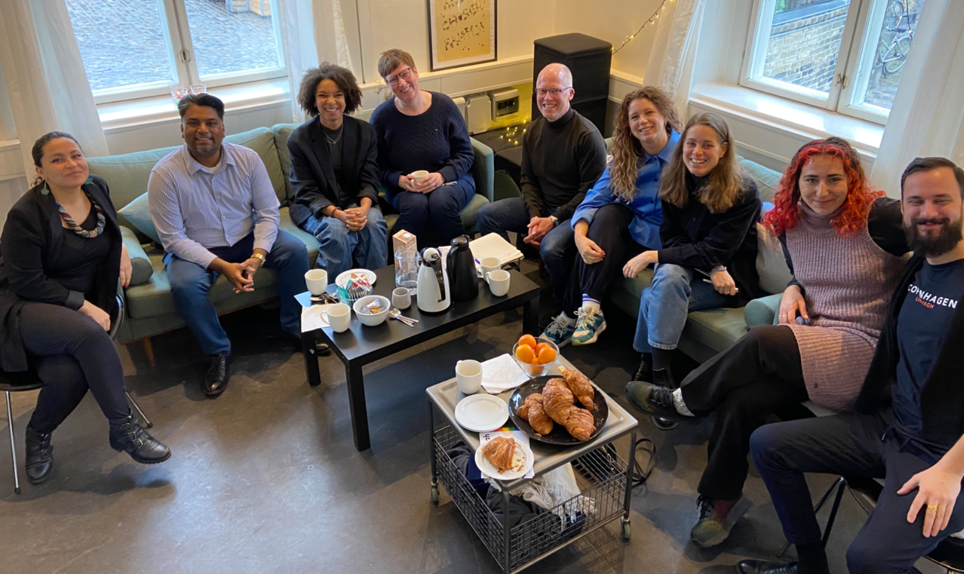
Lessons learned (2)
New Datacollection
Loop-learning
Back to the system (OMG)
Study tour to our big-brother (Copenhagen)

Slide 9
Questions / debate

